Slide 2
Spring Batch 3.0

Slide 3
Agenda
Motivation
But first… do you need a Batch framework?
Requirements we gathered
Why JSR-352/Spring Batch?
JSR-352 Architecture
Challenges
Demo & code!!!!!!!!
Performance
Conclusions
Q&A

Slide 4
Motivation
Some of our projects need batch processing (VDAB, Argenta, VENTOURIS)
DIY?
Why do it yourself if other batch frameworks exist…
Spring Batch (JSR-352 compatible)
JBeret (JSR-352 reference implementation)
Apache Camel anyone?

Slide 5
Do you need a Batch framework?
Some history:
Back when the animals could talk, hardware was expensive
So, to reuse the presentation hardware resources and Batch frameworks were used to do the heavy lifting at night on the same hardware
=> No impact for business users during the day
Today:
Hardware is cheap
Thanks to frameworks like HazelCast, Akka and Vertx.io distributed computing becomes easy…
Do you still need a Batch Framework?

Slide 6
Requirements we gathered
Based on Ventouris
Specific requirements:
Pass along parameters to the Job
Process long running calculation
Run another process at the end of Job
Exception handling: restart a job easily
Run fast!

Slide 7
Why JSR-352/Spring Batch
Investigate if JSR-352 is good for our needs
Spring Batch is compliant with JSR-352
JSR-352 offers XML based configuration, Spring Batch allows Java Configuration
JSR-352 does not implement generics for Readers, Writers and Processors, Spring Batch does
Spring Batch defines comes with a lot of out of the box Readers and Writers
Most of our projects already use Spring
=> Spring Batch seems viable

Slide 8
JSR-352 Architecture
JSR-352 defines the following Batch Domain Model
Job:
abstraction of a process to be executed
composed out of Steps and Tasklets
Can have decision flows
Step
Chunks: has a commit interval
ItemReader: read data (from XML, DB, web, …)
ItemProcessor: transformation of one item in the chunk
ItemWriter: output data is written (to XML, DB, web, …)

Slide 9
JSR-352 Architecture
How to make things go fast?
Single-threaded Step:
one JVM, one item processed at a time
Multi-threaded Step:
one JVM, multiple items processed in parallel
Parallel Steps:
Possible if steps do not depend on each other
one JVM, multiple steps running in parallel
Remote Chunking of Step:
Multiple JVMs, data is read by master and pushed to slaves, multiple items running in parallel
Partitioning a Step:
Multiple JVMs, id to process is read by master and pushed to slaves, slave read data theirselves, multiple items running in parallel

Slide 10
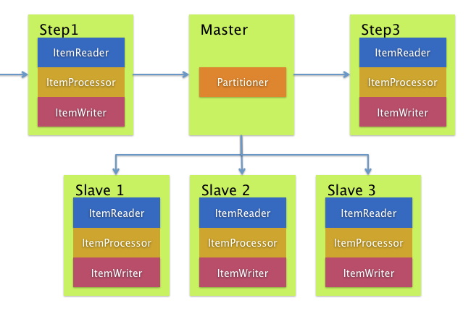
Challenges
How to do error handling?
Retry template
Give jobs and steps the ability to restart
How to make things go fast?
Remote partitioning and multithreading So, a clustered setup
What if a Slave goes down…

Slide 11
Demo
Show it in real life!
But also, show me the code!

Slide 12
Performance tests
Scenario | Running time
Single JVM single threaded | 18:00
Single JVM, multi threaded | 5:00
Multi JVM - 2 slaves, single threaded | 10:00
Multi JVM – 4 slaves, single threaded | 5:30
Multi JVM – 2 slaves, multi threaded | 3:00
Multi JVM - 4 slaves, multi threaded | 2:05
Details
https://github.com/cegeka/batchers/tree/master/taxcalculator-blog/article7-performance-testing

Slide 13
Conclusions
Ask yourself if you really need a Batch
Spring Batch 3.0 has a steep learning curve
Documentation is scarce for Spring Batch 3.0
Lot’s of configuration
But! Lessons are learned now and shared via:
https://github.com/cegeka/batchers
Cegeka Blog
So, startup should be a lot easier!

Slide 14

Q&A

